Slide 1


AN6003
Analytics Strategy
Group Members
DELWIN RAMSES VAN STRIEN
JO BUM JOON
NGUYEN NGOC THIEN HUONG
ZHANG JIANYU
ZHANG NING
ZHAO HENGJIE

Slide 2

01 - Introduction
02 - Descriptive Statistics
03 - Predictive Models
04 - Conclusions

Slide 3

01 - Introduction

Slide 4
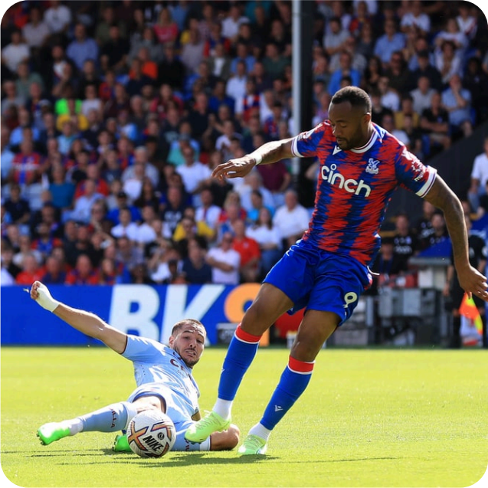
Injury Prevention in University Football
Football injuries remain a key
challenge at the university level.
They affect player health, team
performance, and resource planning.
Data analytics enables proactive
prevention instead of reactive
response.
Presented By : Zhang Jianyu

Slide 5
From Challenge to Goal
Problem
Objective
Impact
How can management
identify high-risk players
before injuries occur?
Use analytics to improve
player safety and optimize
training decisions.
Better performance,
fewer absences, smarter
resource allocation.
Presented By : Zhang Jianyu

Slide 6

University Football Injury Dataset
Dataset Summary
Football Metrics
Position, Match
hours, Injury
history
Fitness
Agility, Knee
strength, Sprint
speed
Training
Compliance
Warm-up adherence, Attendance
800 players aged 18–24
from collegiate & provincial leagues
18 input features grouped into 5 categories
Target: Injury Next Season ( ≥ 7 days absence)
Physical
Height, Weight, BMI
Lifestyle
Sleep, Stress, Nutrition
Presented By : Zhang Jianyu

Slide 7
Analytical Framework
Two-Stage Analytical Approach
Stage 1 – Overall Actions
Logistic Regression & Random Forest
Predict injury likelihood and identify key factors
Stage 2 – Detailed Threshold
Clustering & CART
Segment players and determine actionable risk rules
Stage 1: Prediction
(LR, RF)
Stage 2: Segmentation
(Clustering, CART)
Insights & Actions
Dataset
Presented By : Zhang Jianyu

Slide 8

02 - Descriptive Statistics

Slide 9
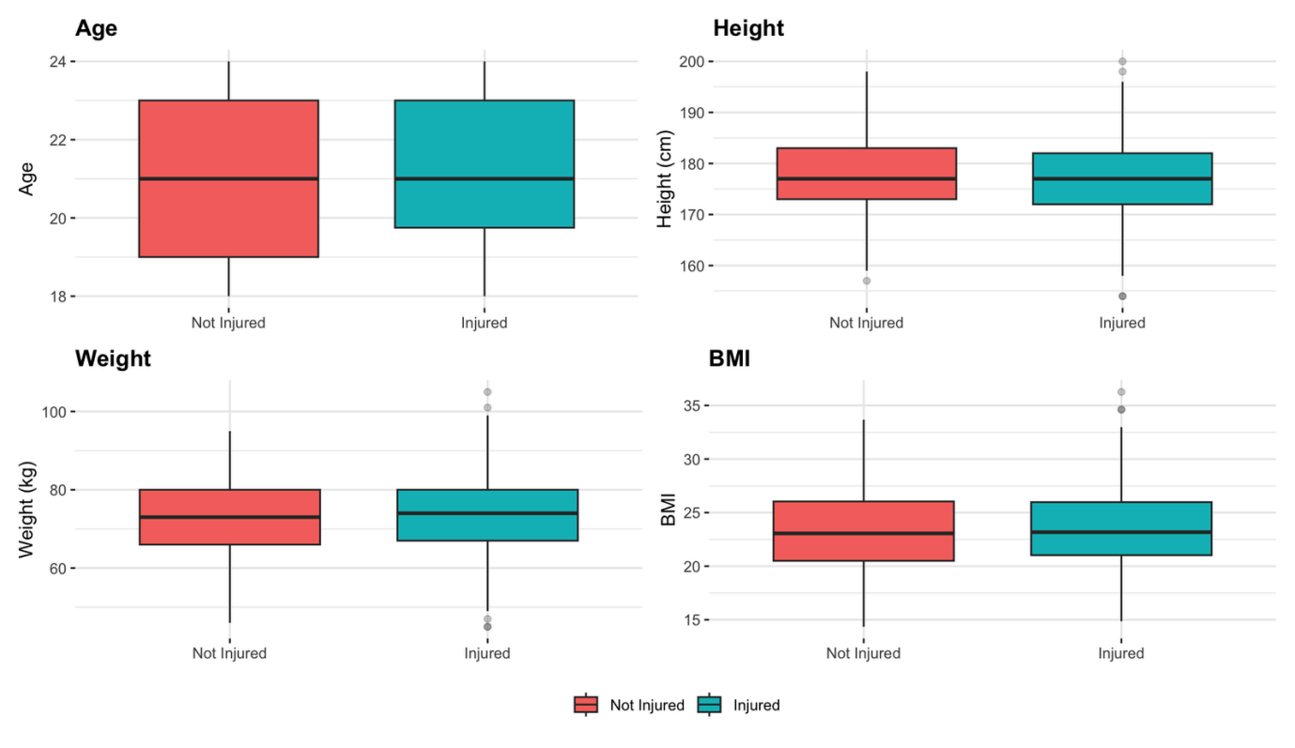
No significant differences in physical attributes
Presented By : Nguyen Ngoc T hien Huong

Slide 10

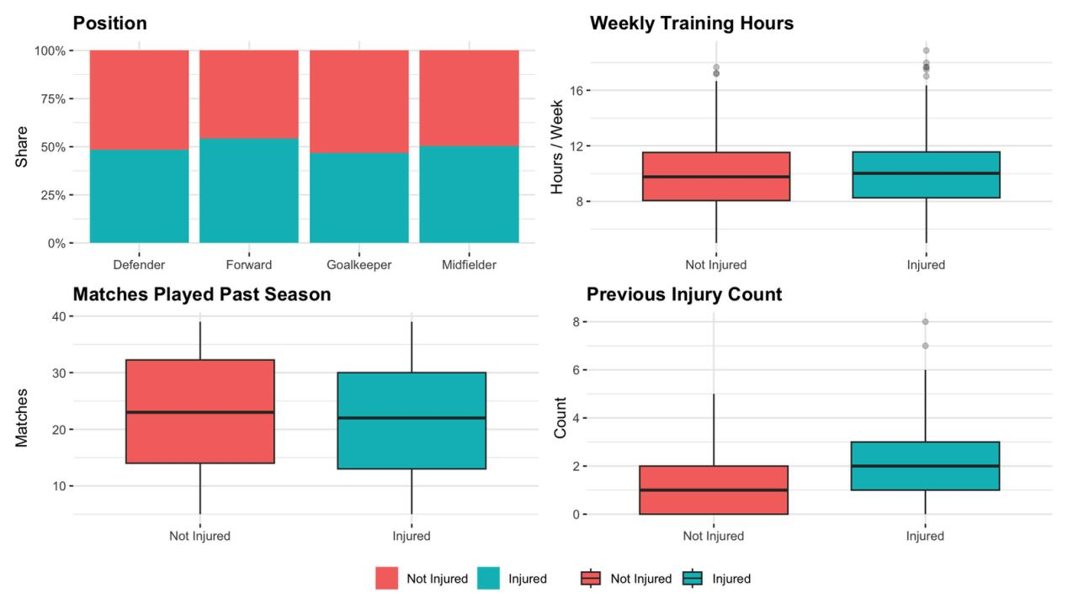
Except for previous injuries, unclear differences
observed other football-specific attributes
Presented By : Nguyen Ngoc T hien Huong

Slide 11

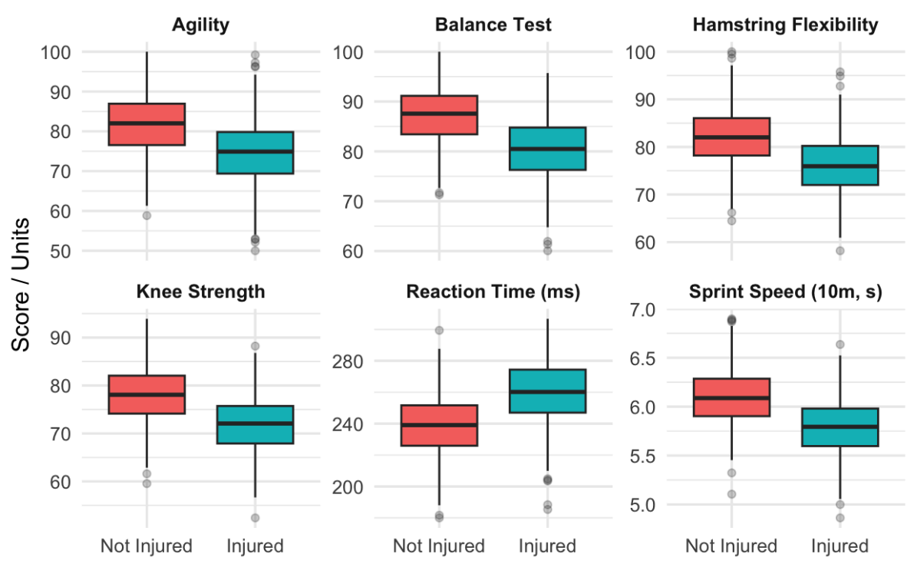
Not injured players score better across physical
assessment factors
Presented By : Nguyen Ngoc T hien Huong

Slide 12

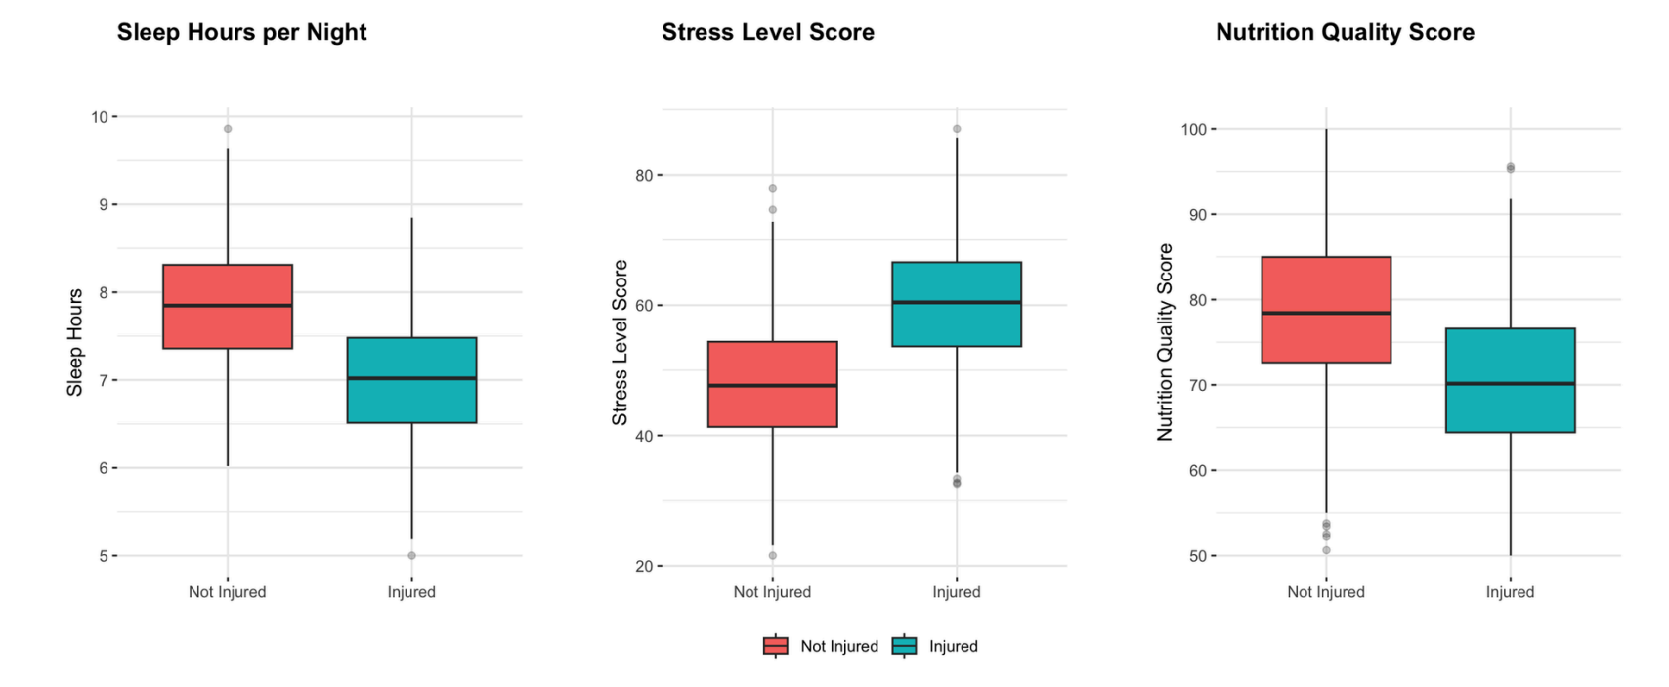
Not injured players also have more sleep, higher
nutrition quality and lower stress level
Presented By : Nguyen Ngoc T hien Huong

Slide 13
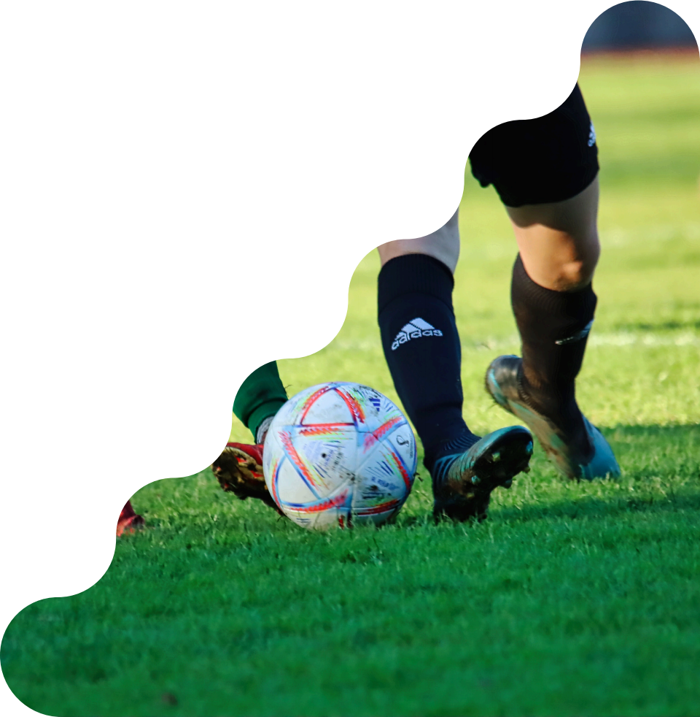
03 ⁻ Predictive Models

Slide 14
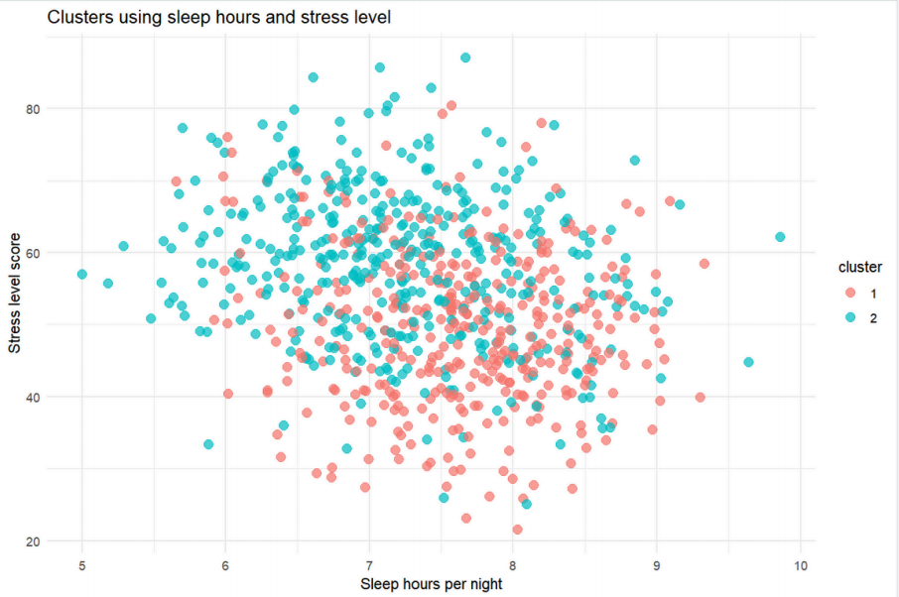
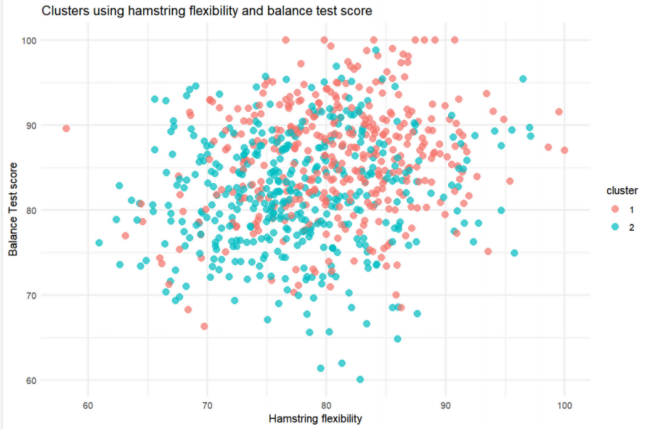
Clustering
Injury Rate
Cluster 1: 21.4%
Cluster 2: 76.8%
Noticeable gaps between injury-prone and injury-resistant groups ⟶ baseline for further guidelines
Presented By : Zhao Hengjie

Slide 15
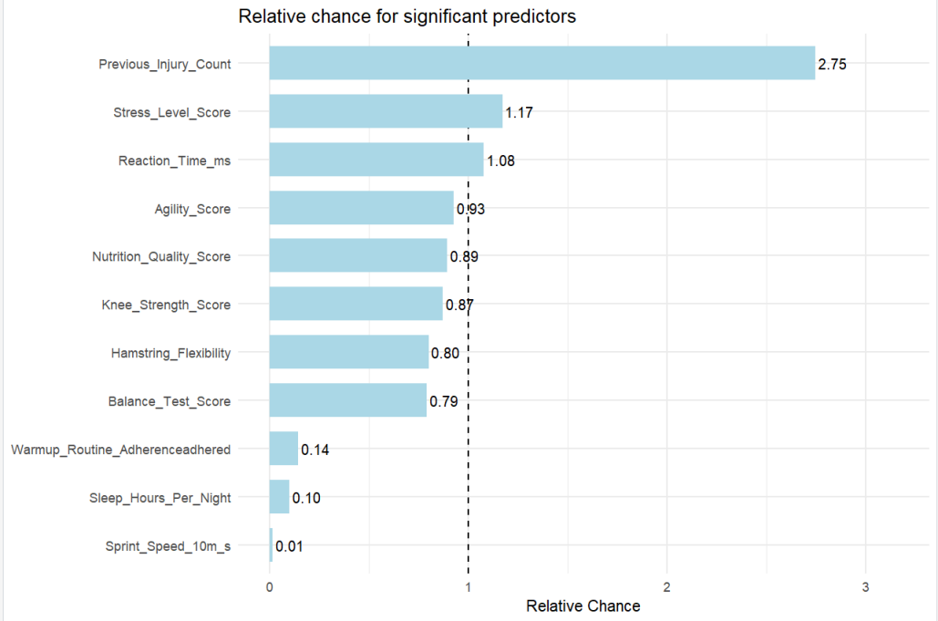
Logistic regression
Important findings
Football-Specific Metrics:
One more previous injury, twice more likely to get injured.
Fitness Assessments:
1 unit increase in balance test score, 21% less likely to get injured.
Lifestyle Factors:
1 more hours of sleep, 90% less likely to get injured.
Training Compliance:
If the player adheres to the warm-up routine, he/ she is 86% less likely to get injured.
Presented By : Zhao Hengjie

Slide 16
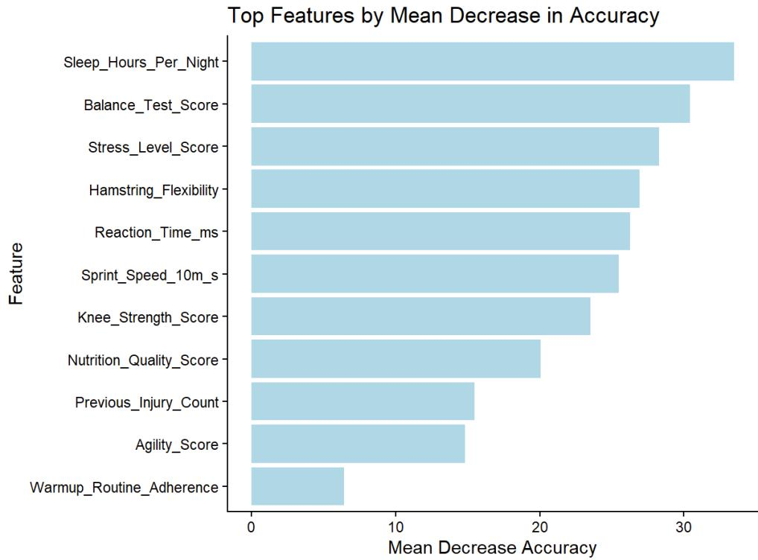

Random Forest Model
Top Influencing Factors
Lifestyle factors:
Sleep_Hours_Per_Night,
Stress_Level_Score,
Nutrition_Quality_Score
Physical Fitness Assessment factors:
Balance_Test_Score,
Hamstring_Flexibility,
Reaction_Time_ms
Football-specific factor:
Previous_Injury_Count
Training Compliance factor:
Warmup_Routine_Adherence
Presented By : Zhang Ning

Slide 17
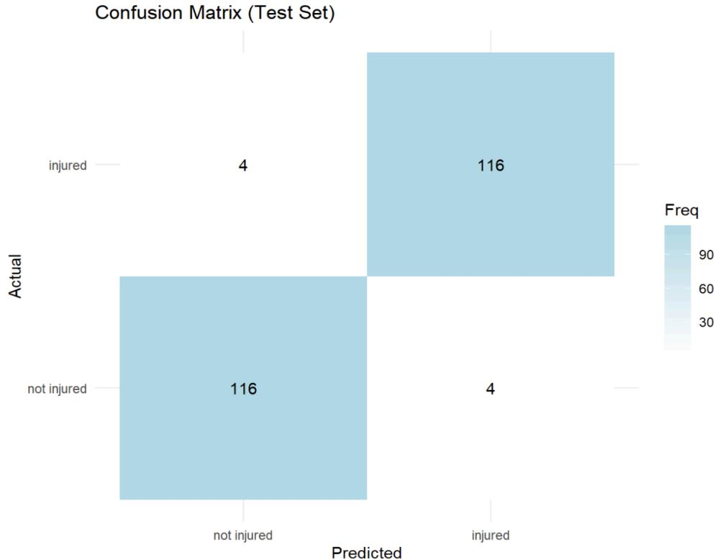


Random Forest Model
Accuracy: 96.67%
Top Right: successfully predicted as
“unlikely to be injured”
Low-Risk Group
Bottom Left: successfully predicted as
“ likely to be injured”
High-Risk Group
Need more attention!!!
Presented By : Zhang Ning

Slide 18
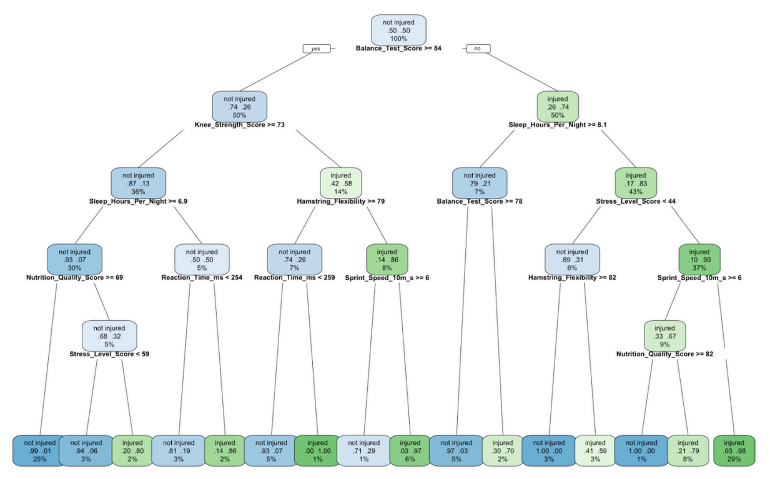
Classification and Regression Tree
Pruned Decision Tree
Predicts whether a player will be
injured or not next season.
Each split shows a threshold where injury risk changes noticeably.
Helps coaches and staff see which
factor combinations are linked to
higher or lower injury risk.
Presented By : Delwin Ramses van Strien

Slide 19

04 - Conclusions

Slide 20
Action Plan
Factor Group | Factor | Target Threshold | Recommended Action
Physical Factors | Balance Test Score | ≥ 84 | Perform balance and stability exercises to reach or maintain a high balance score.
 | Hamstring Flexibility | ≥ 82 | Perform regular hamstring stretching and mobility exercises.
 | Reaction time ms | < 254 | Engage in reaction and agility drills to improve response times.
 | Sprint Speed m/s | ≥ 6 | Include sprint and speed drills to maintain optimal quickness and reduce injury risk.
 | Knee Strength Score | ≥ 73 | Incorporate strength training focused on knees and lower limbs.
Lifestyle Factors | Sleep Hours Per Night | ≥ 8.1 | Aim for at least 8 hours of sleep each night to support recovery.
 | Stress Level Score | < 44 | Practice stress management techniques such as mindfulness or relaxation exercises.
 | Nutrition Quality Score | ≥ 82 | Follow a balanced diet and consult nutrition professionals to optimize performance.
Presented By : Delwin Ramses van Strien

Slide 21

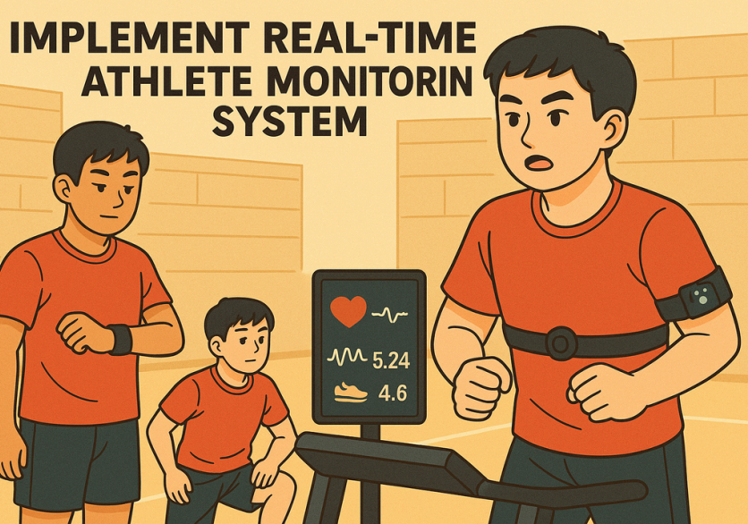
Conclusions
Implement Real Time Athlete Monitoring System
Predictive Analytics in University Sports Management
Demonstrates how data-driven models
enhance injury prevention and athlete well-being
Combines Logistic Regression, Random
Forest, Clustering, and CART to
achieve high predictive accuracy
Bridges statistical modeling with
practical, actionable insights for
coaching and medical teams
Presented By : Jo Bum Joon

Slide 22

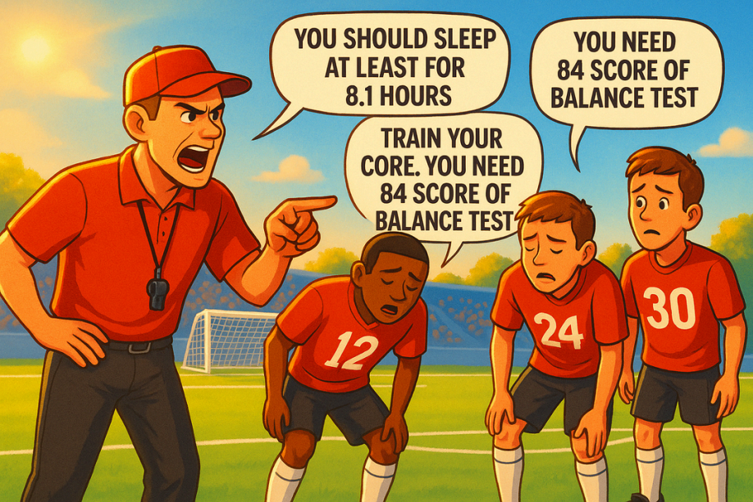
Recommendations
Early Warning Detection,
Proactive Recovery Plan,
Adaptive Training
Practice & Lifestyle Guidelines
Establish a compilation of practice and
lifestyle guidelines to avoid injuries
Early Preventive Actions
Identify injury-prone athletes for early
adjustments and prevention
Athlete Monitoring Systems
Implement a real-time monitoring system
to help manage injury risk proactively
Presented By : Jo Bum Joon

Slide 23
Thanks

Slide 24
Appendix

Slide 25
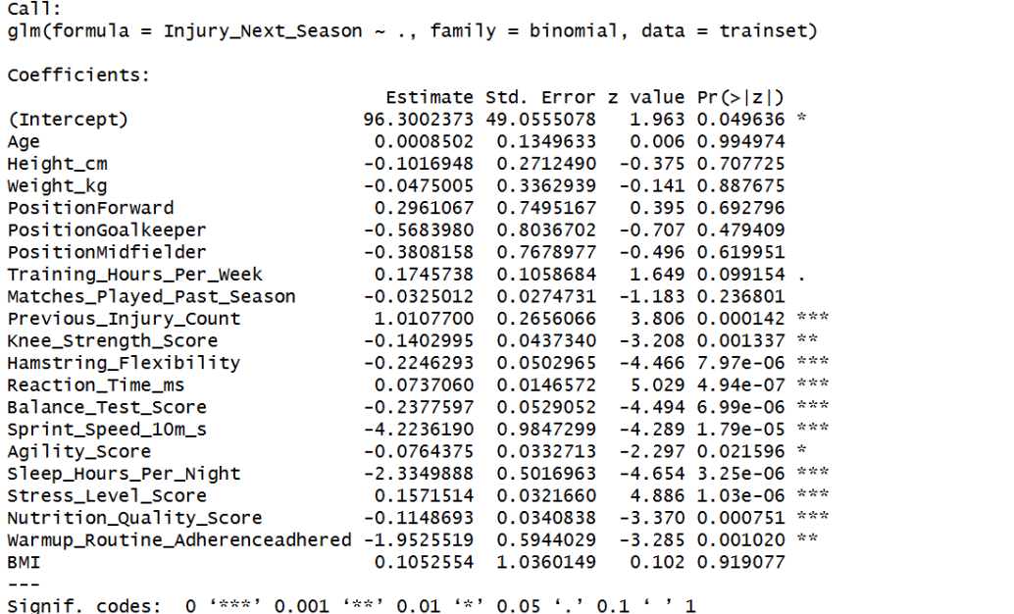
Logistic Regression Model
Significant variables
Football-specific metrics:
previous injury count
fitness assessments:
knee strength, hamstring flexibility, reaction time, balance score, sprint speed, agility
score
lifestyle factors:
sleep hours, stress level, nutrition quality
Training compliance:
warm-up routine adherence

Slide 26
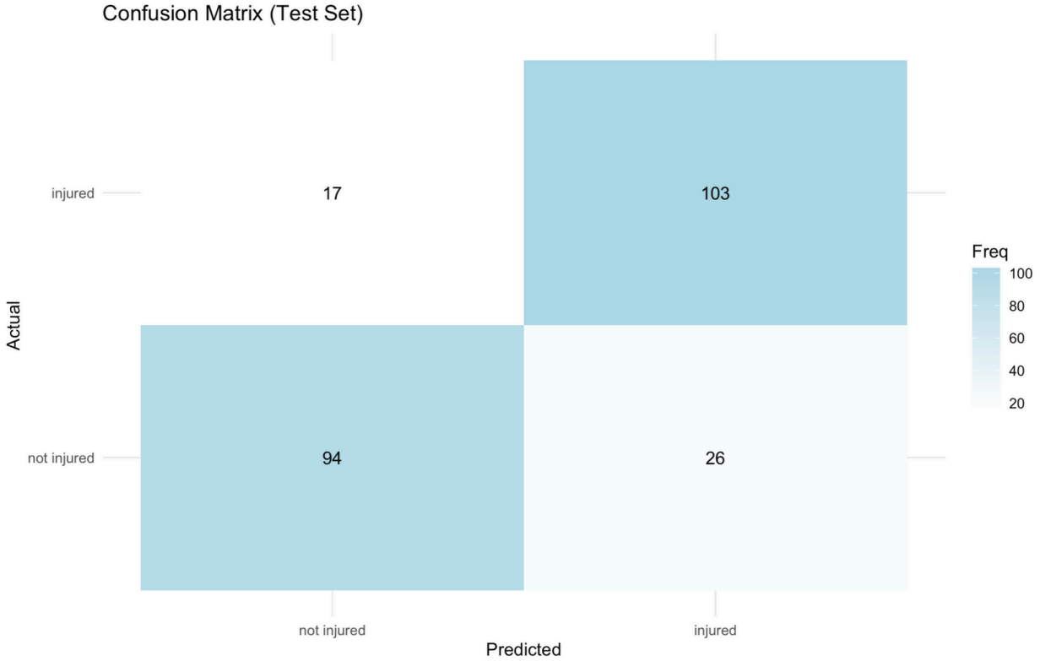
Classification and Regression Tree
CART Model Predictions vs Actual Injury Rates
Accuracy: 82.1%
Presented By : Delwin Ramses van Strien

Slide 27
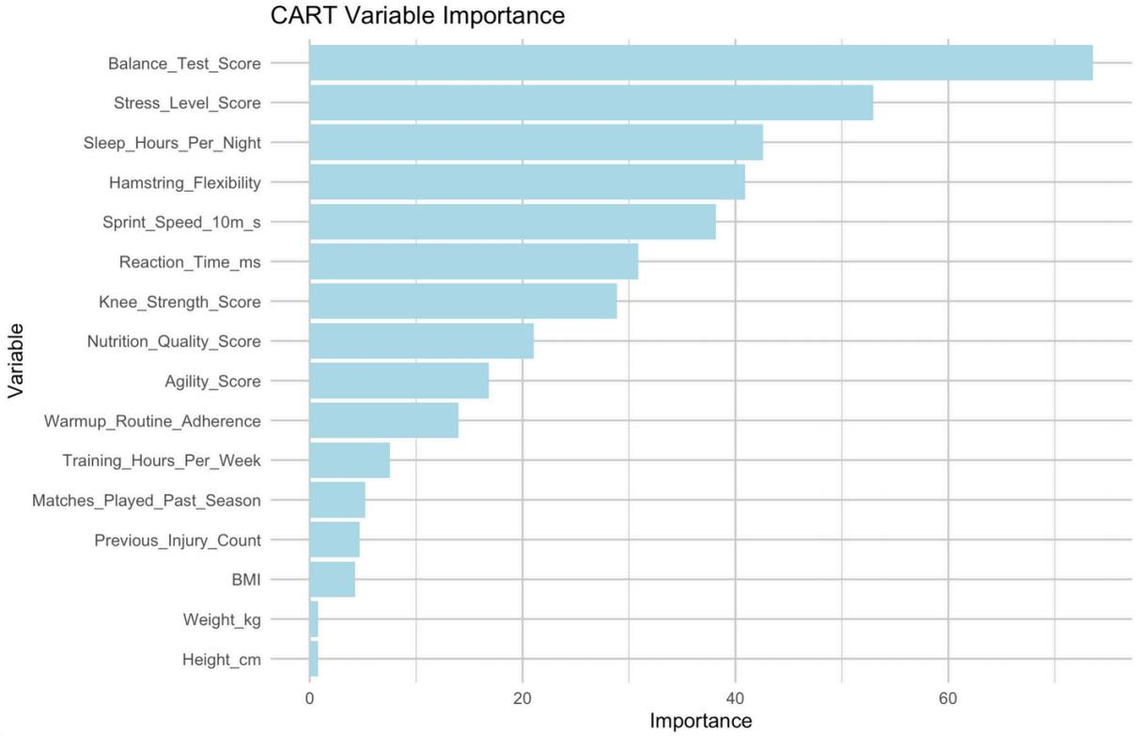
CART Most Important Variables
Top Influencing Factors
Physical Assessment Factors
Balance Test Score
Hamstring Flexibility
Sprint Speed m/s
Lifestyle Factors
Stress Level Score
Sleep Hours Per Night
Nutrition Quality Score
Training Compliance Factor
Warmup Routine Adherence
Presented By : Delwin Ramses van Strien

